Slide 1
FinanceTracker
Presentation: WS 23/24 Praktikum Ingenieursmäßige Software-Entwicklung
Presenters: Tim Lachenicht & Tobias Kässmann
Supervisors: Dr. Yves Kirschner & Prof. Ralf Reussner
Karlsruhe 15.03.2024

Slide 2
Motivation
Goal: Develop a benchmark application for scientific analysis.
Requirements: Software has the following characteristics:

Slide 3


Motivation
Goal: Develop a benchmark application for scientific analysis.
Requirements: Software has the following characteristics:
Microservice
Architecture
Framework: Spring (Java), Maven
Deployment: Docker

Slide 4

Motivation
Goal: Develop a benchmark application for scientific analysis.
Requirements: Software has the following characteristics:
Microservice
Architecture
Heterogene Technologies
Framework: Spring (Java), Maven
Deployment: Docker
API: JAX-RS & Spring
Message Queue

Slide 5

Motivation
Goal: Develop a benchmark application for scientific analysis.
Requirements: Software has the following characteristics:
Microservice
Architecture
Heterogene Technologies
Complex Source Code
Framework: Spring (Java), Maven
Deployment: Docker
API: JAX-RS & Spring
Message Queue

Slide 6
Motivation
Goal: Develop a benchmark application for scientific analysis.
Requirements: Software has the following characteristics:
Microservice
Architecture
Heterogene Technologies
Complex Source Code
Framework: Spring (Java), Maven
Deployment: Docker
API: JAX-RS & Spring
Message Queue
Develop something great

Slide 7
Microservice Engineering Approach
Requirement Analysis
Domain/Architecture Design
API Specification
Implementation & Test
Deployment

Slide 8
Microservice Engineering Approach
Requirement Analysis
Goal:
Express requirements
Artifacts:
Story
Capabilities
Use Cases
Domain/Architecture Design
API Specification
Implementation & Test
Deployment

Slide 9
Microservice Engineering Approach
Requirement Analysis
Goal:
Model application domains and software architecture
Artifacts:
Domain Models
Software Architecture
Domain/Architecture Design
API Specification
Implementation & Test
Deployment

Slide 10
Microservice Engineering Approach
Requirement Analysis
Goal:
Derive microservices (MS) from domains
Specify API for each MS
Artifacts:
OpenAPI Specifications
Domain/Architecture Design
API Specification
Implementation & Test
Deployment

Slide 11
Microservice Engineering Approach
Requirement Analysis
Goal:
Implement MSs based on domain model and API spec
Test MSs
Artifacts:
Java Source Code
Unit, Integration & E2E Tests
Domain/Architecture Design
API Specification
Implementation & Test
Deployment

Slide 12
Microservice Engineering Approach
Requirement Analysis
Goal:
Containerize MSs
Artifacts:
Dockerfiles
Docker Compose
Domain/Architecture Design
API Specification
Implementation & Test
Deployment

Slide 13

Story
Lars

Slide 14

Story
Lars
owns
Bank Account

Slide 15

Story
has
Lars
Income & Expense
owns
transferred via
Bank Account

Slide 16

Story
has
Lars
Income & Expense
owns
part of
transferred via
Product
Bank Account

Slide 17


Story
has
has
Lars
to make
Income & Expense
Savings Goal
Vacation
owns
part of
transferred via
on
Product
Bank Account

Slide 18

Story
has
has
Lars
to make
Income & Expense
Savings Goal
Vacation
owns
part of
transferred via
on
Product
Bank Account
budget & forecast
diet
Analytics

Slide 19


Story
has
has
Lars
to make
Income & Expense
Savings Goal
Vacation
owns
part of
transferred via
on
Product
Bank Account
budget & forecast
diet
Analytics

Slide 20

Bank Account
BankAccount
View
Bank Accounts
Create
Bank Account
Delete
Bank Account

Slide 21
Transaction: Income & Expense
Transaction
View Transactions
Create Transaction
BankAccount
Transfer Transaction
Delete Transaction
<<includes>>
Rollback Transaction

Slide 22
Product
Product
Add Product to Shopping Cart
<<includes>>
Create Product
<<extends>>
NutritionAPI
Add Product to Supplies
Add Nutrition
Purchase
Shopping Cart
Transaction

Slide 23
Savings Goal
SavingsGoal
<<includes>>
View Status
View Savings Goal
Transaction
Link Savings Bank Accounts
<<extends>>
Create Savings Goal
BankAccount
Link Rule Bank Accounts
<<extends>>

Slide 24
Analytics
Analytics
SavingsGoal
View Forecast
<<includes>>
Transaction
Generate Report
<<includes>>
View Budget
BankAccount
<<includes>>
View Diet
Create Budget Plan
Product

Slide 25

Software Architecture
UI-FinanceTracker
Product
Transaction
SavingsGoal
BankAccount
Analytics

Slide 26
Software Architecture
[L]
UI-FinanceTracker
[L]
[L]
[K]
Product
Transaction
SavingsGoal
[L]
[K]
BankAccount
Analytics

Slide 27
Software Architecture
[L]
UI-FinanceTracker
[L]
[L]
[K]
Product
Transaction
SavingsGoal
[L]
[K]
BankAccount
Analytics

Slide 28
Software Architecture
[L]
UI-FinanceTracker
[L]
[L]
[K]
Product
Transaction
SavingsGoal
[L]
[K]
BankAccount
Analytics

Slide 29
Software Architecture
[L]
UI-FinanceTracker
[L]
[L]
[K]
Product
Transaction
SavingsGoal
[L]
[K]
BankAccount
Analytics

Slide 30
Software Architecture
[L]
UI-FinanceTracker
[L]
[L]
[K]
Product
Transaction
SavingsGoal
[L]
[K]
BankAccount
Analytics

Slide 31
Savings Goal

Slide 32
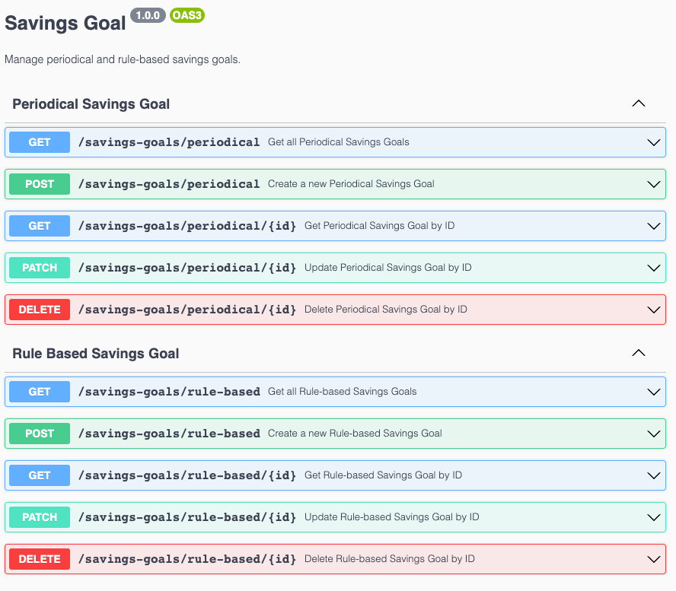
Savings Goal

Slide 33
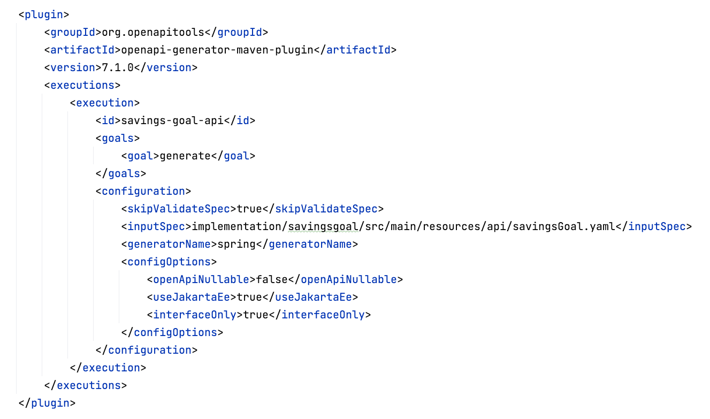
Savings Goal

Slide 34
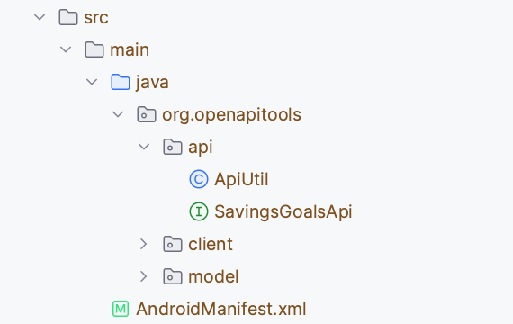
Savings Goal

Slide 35
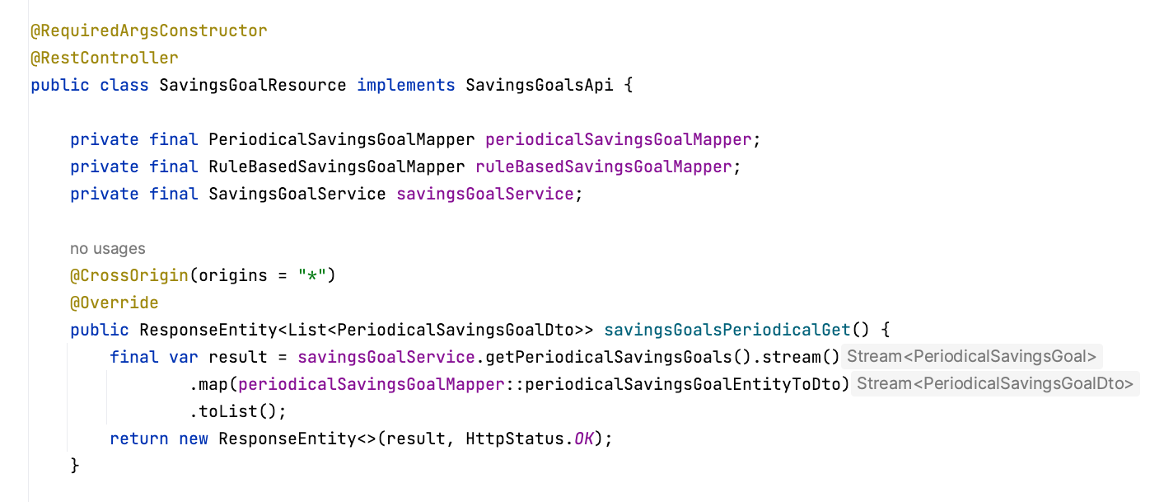
Savings Goal

Slide 36
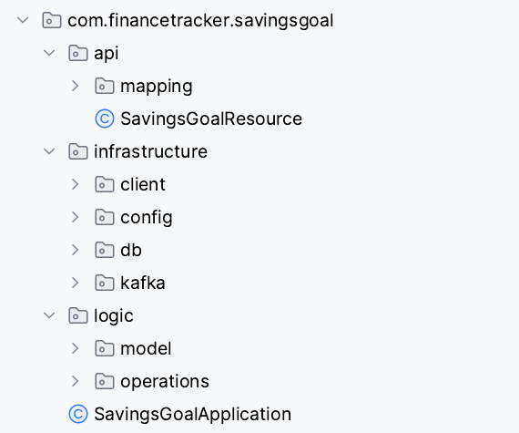
Savings Goal

Slide 37
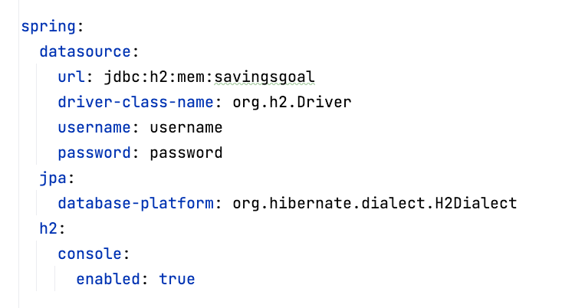
Savings Goal

Slide 38
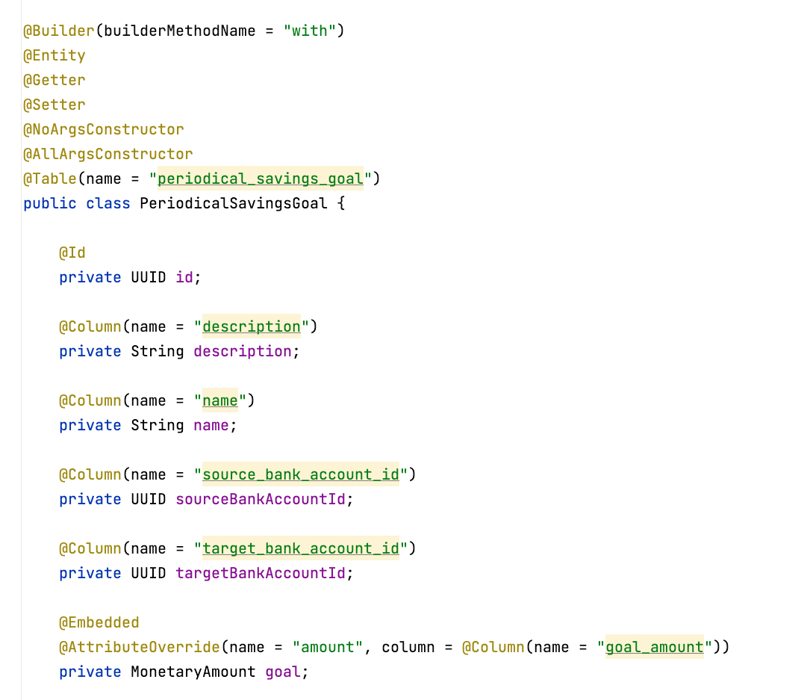
Savings Goal

Slide 39
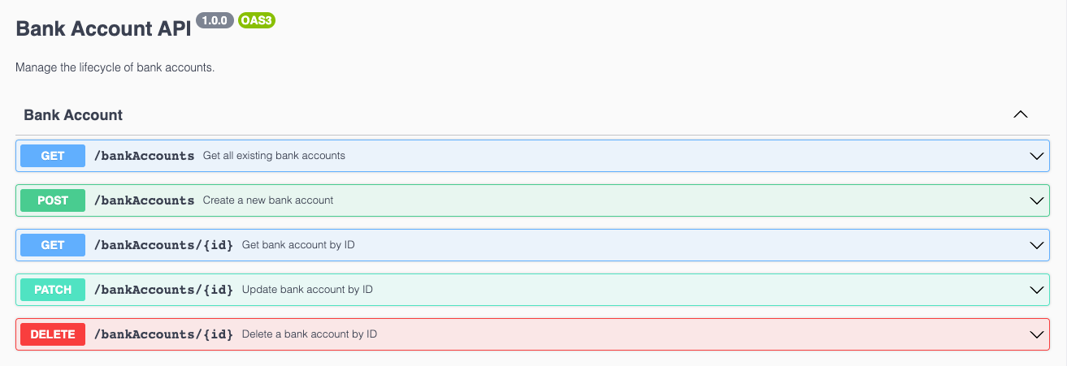
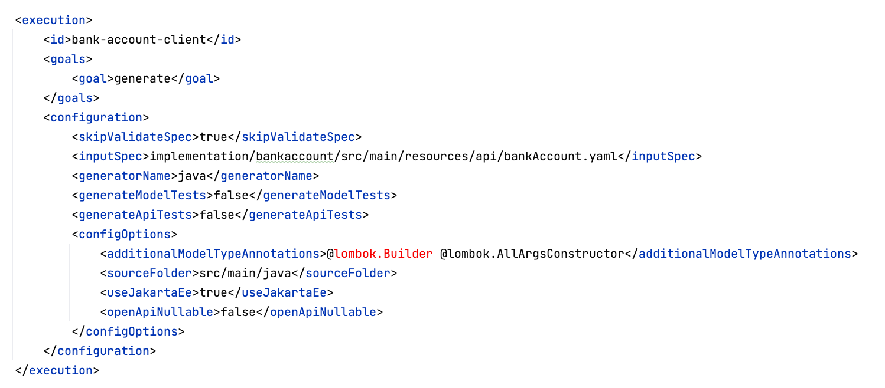
Savings Goal

Slide 40
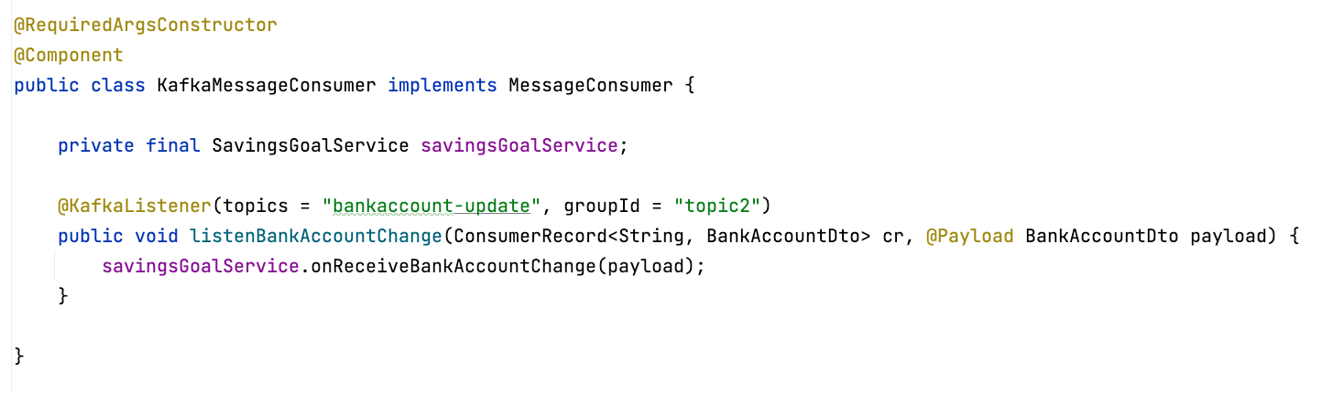
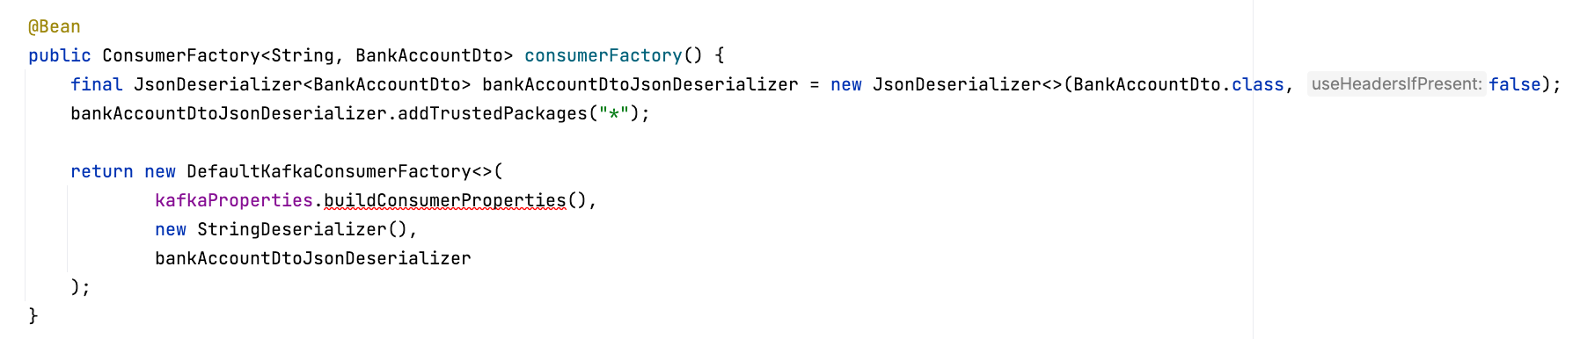
Savings Goal

Slide 41
Testing
E2E Tests
Integration Tests
Unit Tests

Slide 42
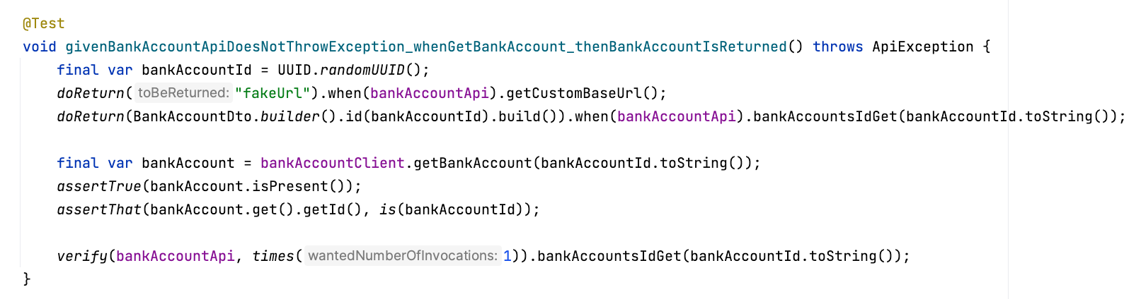
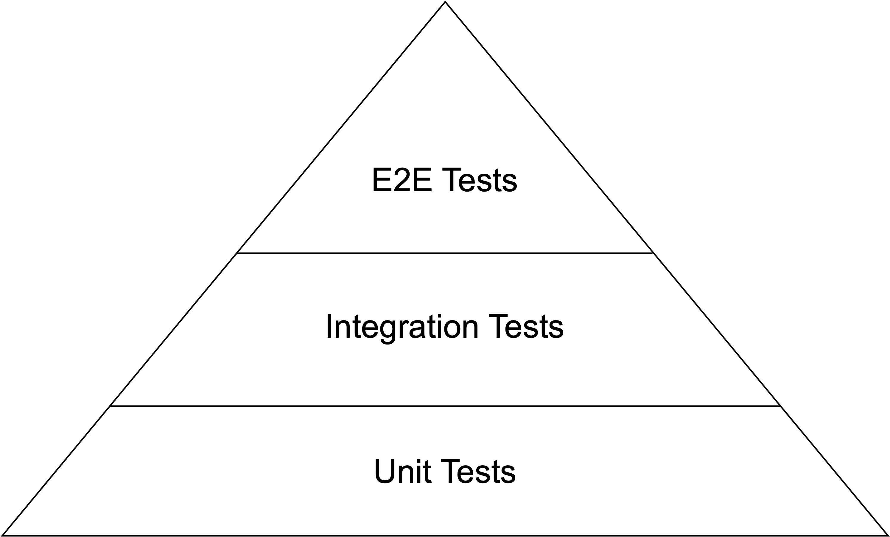
Testing – Unit Tests
Verify small, separable software units
Follow naming convention
Rely on Mockito framework

Slide 43
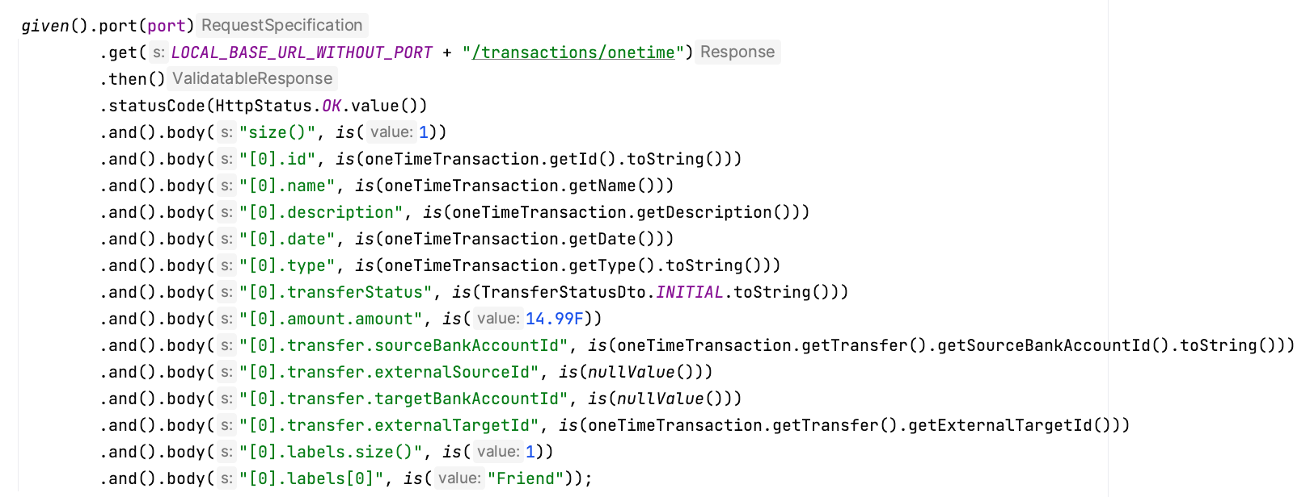
Testing – Integration Tests
Verify interaction of software units
Follow naming convention
Rely on Mockito & RestAssured framework + Spring context

Slide 44
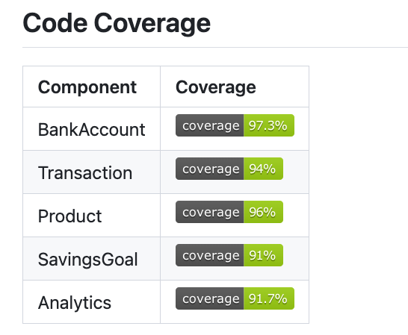
Testing – Unit + Integration Tests

Slide 45
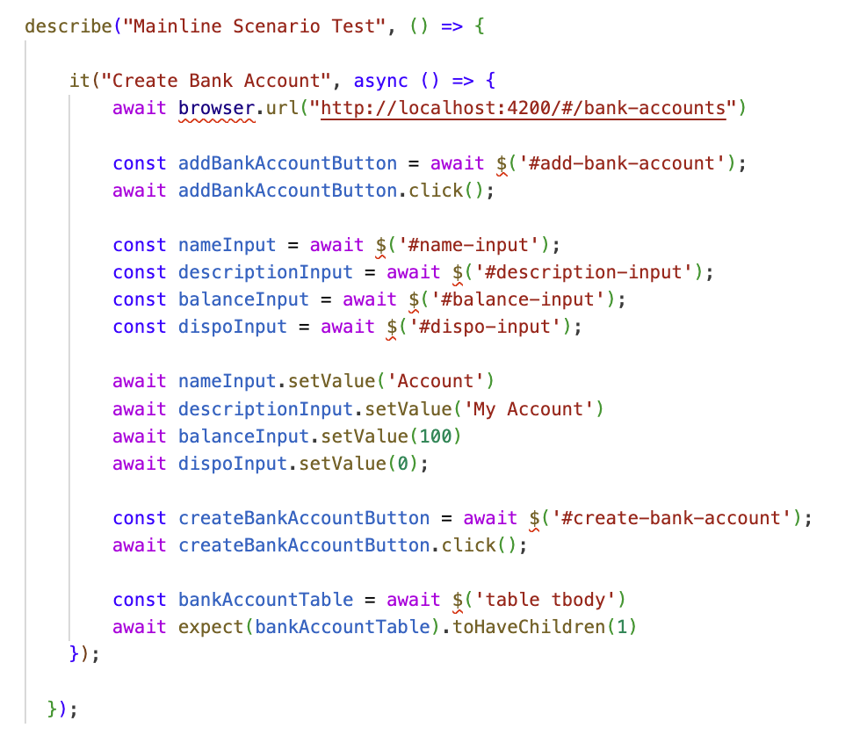
Testing – E2E Tests
Verify the software from a user’s perspective
Rely on Wdio framework

Slide 46
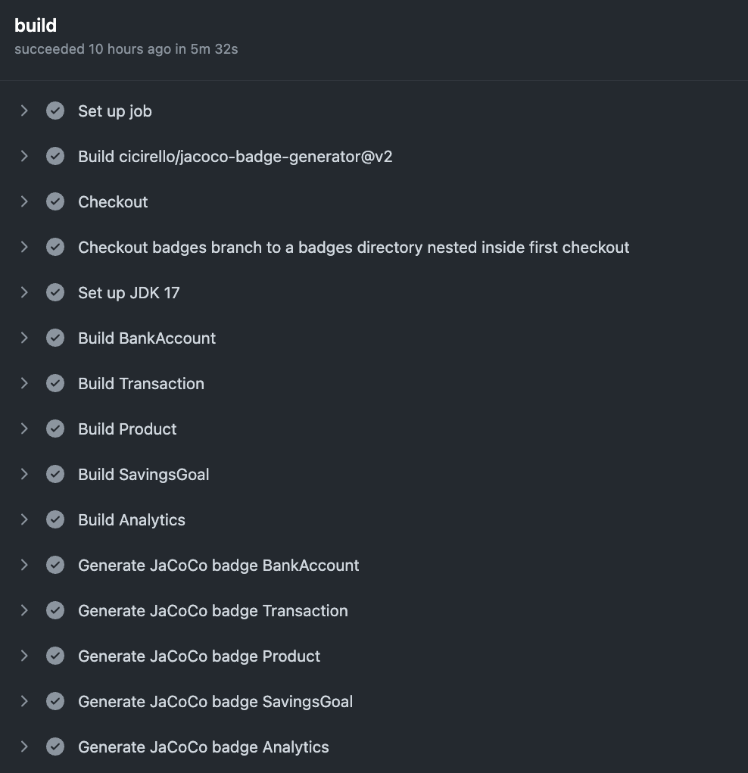
Continuous Integration
Pipeline with Github Workflows
Runs on every PR commit and merge
Executes all unit and integration tests
Executes spell check on markdown files

Slide 47
Local Deployment

Slide 48
Local Deployment
Dockerfile to package each microservice

Slide 49
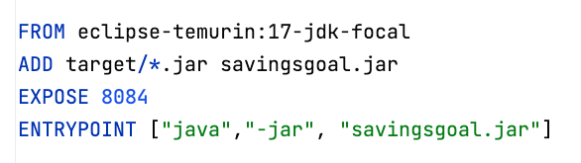
Local Deployment
Dockerfile to package each microservice

Slide 50
Local Deployment
Dockerfile to package each microservice
Docker-Compose to containerize microservice system

Slide 51
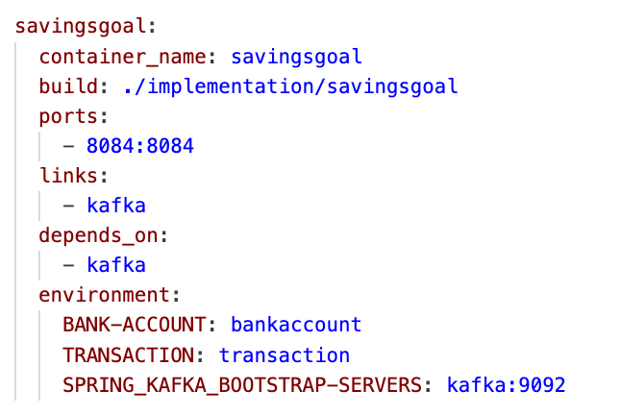
Local Deployment
Dockerfile to package each microservice
Docker-Compose to containerize microservice system

Slide 52
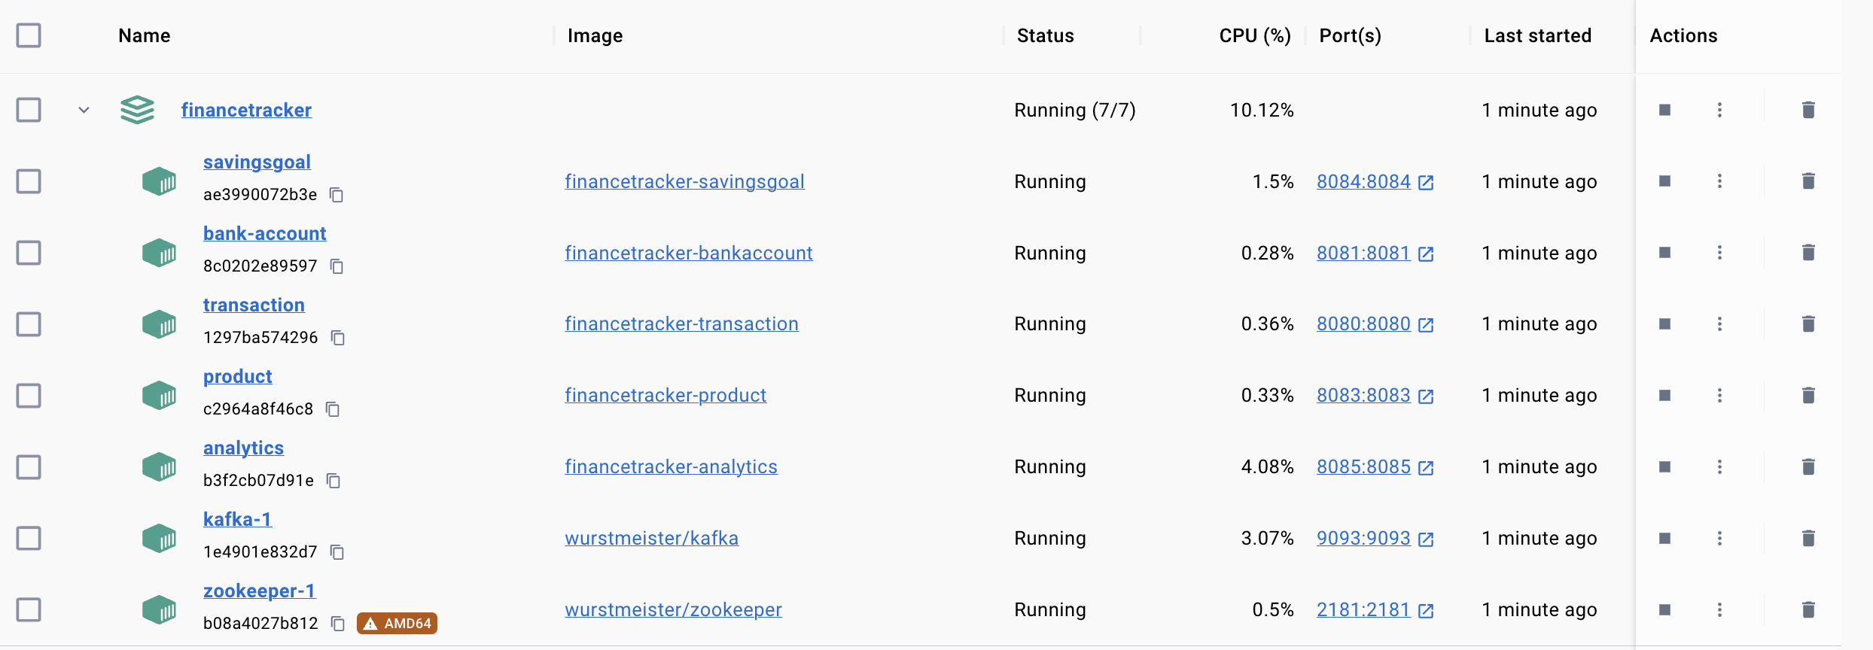
Local Deployment
Dockerfile to package each microservice
Docker-Compose to containerize microservice system

Slide 53
Mainline Scenario
BankAccount
SavingsGoal
Product
User
POST /bankAccounts
account

Slide 54
Mainline Scenario
BankAccount
SavingsGoal
Product
User
POST /bankAccounts
account
POST /savings-goal/rule-based
goal

Slide 55
Mainline Scenario
BankAccount
SavingsGoal
Product
User
POST /bankAccounts
account
POST /savings-goal/rule-based
goal
POST /product
mango

Slide 56
Mainline Scenario
BankAccount
SavingsGoal
Product
User
POST /bankAccounts
account
POST /savings-goal/rule-based
goal
POST /product
mango
POST /shopping-cart
shoppingCart with mango

Slide 57
Mainline Scenario
BankAccount
SavingsGoal
Product
Transaction
User
POST /shopping-cart/purchase
POST /transactions/one-time
PATCH /bankAccounts

Slide 58
Mainline Scenario
BankAccount
SavingsGoal
Product
Transaction
User
POST /shopping-cart/purchase

Slide 59
Mainline Scenario
BankAccount
SavingsGoal
Product
Transaction
User
POST /shopping-cart/purchase
POST /transactions/one-time

Slide 60
Mainline Scenario
BankAccount
SavingsGoal
Product
Transaction
User
POST /shopping-cart/purchase
POST /transactions/one-time
PATCH /bankAccounts

Slide 61
Mainline Scenario
BankAccount
SavingsGoal
Product
Transaction
User
POST /shopping-cart/purchase
POST /transactions/one-time
PATCH /bankAccounts
KAFKA bank-account-update

Slide 62
Mainline Scenario
BankAccount
SavingsGoal
Product
Transaction
User
POST /shopping-cart/purchase
POST /transactions/one-time
PATCH /bankAccounts
KAFKA bank-account-update
success
success

Slide 63
Mainline Scenario
BankAccount
SavingsGoal
Product
Transaction
User
POST /shopping-cart/purchase
POST /transactions/one-time
PATCH /bankAccounts
KAFKA bank-account-update
success
success
mango has been purchased

Slide 64
Mainline Scenario
Product
Analytics
User
PATCH /supplies/mango

Slide 65
Mainline Scenario
Product
Analytics
User
PATCH /supplies/mango
KAFKA product-update
success

Slide 66
Mainline Scenario
Product
Analytics
User
PATCH /supplies/mango
KAFKA product-update
success
GET /nutrition
nutrition

Slide 67
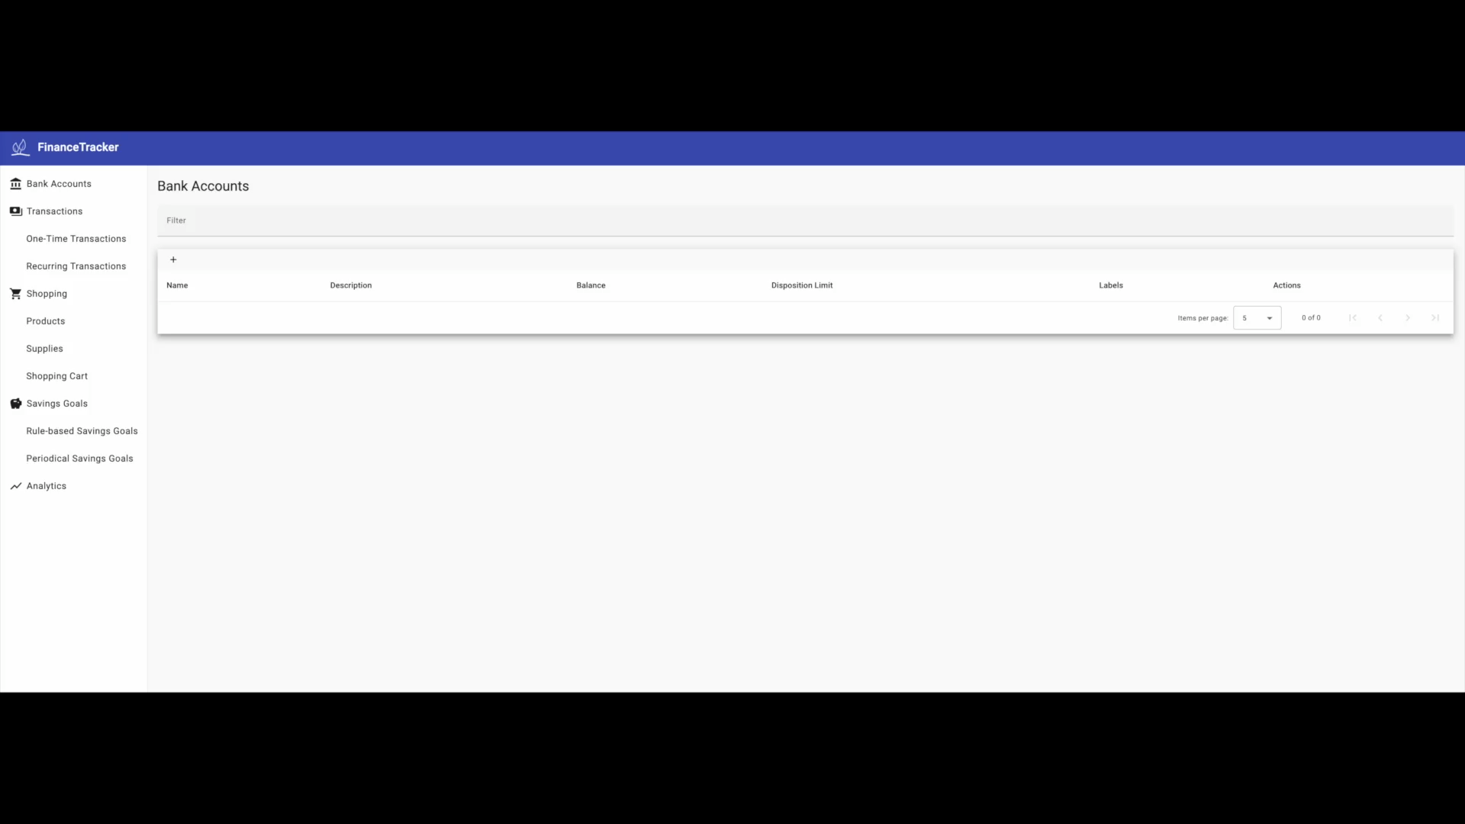
Demo

Slide 68
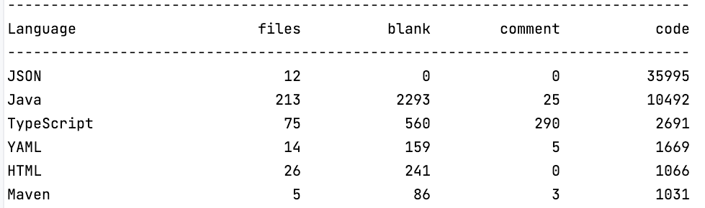
Conclusion
Finance-Tracker: Software for managing personal finances
Project Repository
https://github.com/Uinyw/financetracker
Open Source – Apache-2.0 license

